Slide 1
Aircraft Plane Crash since 1908
Mbongeni Sithole

Slide 2
AGENDA
Introduction
Data Preparation
10 Year Period Analysis
Time Of Crashes
Most Severe Crash
World War II Crashes and Aircraft Types
Total Fatalities over time
Summary

Slide 3
INTRODUCTION
Mbongeni Sithole, Data Analyst at TW Profile Services.
A data enthusiast. Google Data Analyst Certified. Currently working on IBM’s Data Scientist Certificate.
Aviation accidents from around the world from 1908-2019 with information scrapped from planecrashinfo.com
Information on aircraft types, periods of most accidents, fatalities and accidents due to thunder/lighting has been gathered in this presentation.

Slide 4
Data preparations

Slide 5
How I prepared my data for analysis
Converted all columns to required data type before loading.
Data was checked for duplicate rows and blank rows.
Summarize data into smaller tables for specific questions.

Slide 6
10-year period

Slide 7
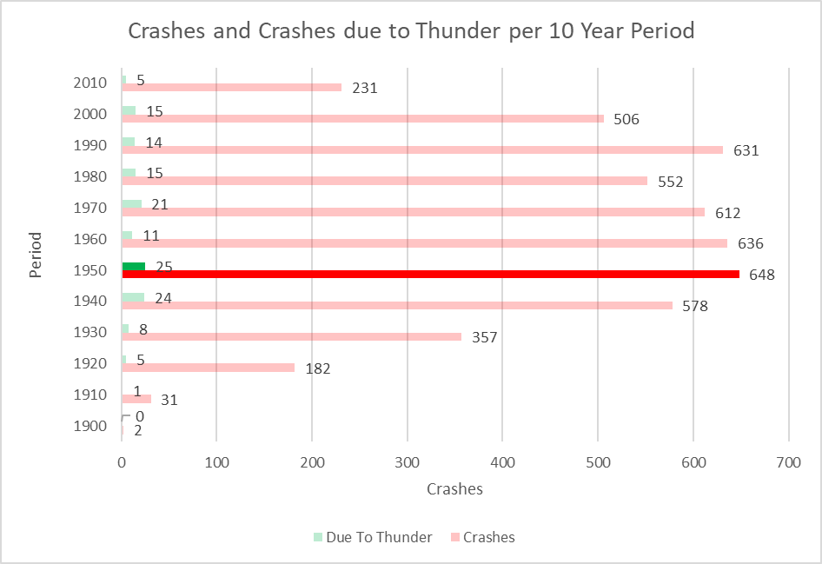
Crashes in 10-year period
Period | Crashes | Fatalities | Crashes due to Thunder
1900s | 2 | 2 | 0
1910s | 31 | 424 | 1
1920s | 182 | 647 | 5
1930s | 357 | 2033 | 8
1940s | 578 | 8881 | 24
1950s | 648 | 11779 | 25
1960s | 636 | 16884 | 11
1970s | 612 | 19751 | 21
1980s | 552 | 16847 | 15
1990s | 631 | 15984 | 14
2000s | 506 | 11174 | 15
2010s | 231 | 6369 | 5

Slide 8
Crashes in 10-year period
Period | Crashes | Fatalities | Crashes due to Thunder
1900s | 2 | 2 | 0
1910s | 31 | 424 | 1
1920s | 182 | 647 | 5
1930s | 357 | 2033 | 8
1940s | 578 | 8881 | 24
1950s | 648 | 11779 | 25
1960s | 636 | 16884 | 11
1970s | 612 | 19751 | 21
1980s | 552 | 16847 | 15
1990s | 631 | 15984 | 14
2000s | 506 | 11174 | 15
2010s | 231 | 6369 | 5

Slide 9
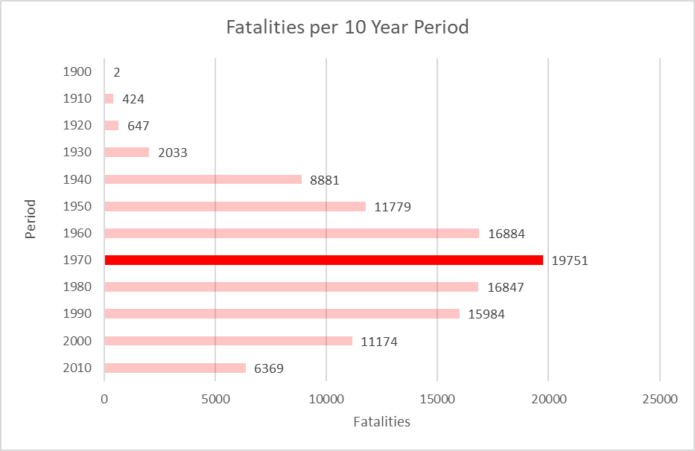
fatalities in 10-year period
Period | Crashes | Fatalities | Crashes due to Thunder
1900s | 2 | 2 | 0
1910s | 31 | 424 | 1
1920s | 182 | 647 | 5
1930s | 357 | 2033 | 8
1940s | 578 | 8881 | 24
1950s | 648 | 11779 | 25
1960s | 636 | 16884 | 11
1970s | 612 | 19751 | 21
1980s | 552 | 16847 | 15
1990s | 631 | 15984 | 14
2000s | 506 | 11174 | 15
2010s | 231 | 6369 | 5

Slide 10
Time of Crashes

Slide 11
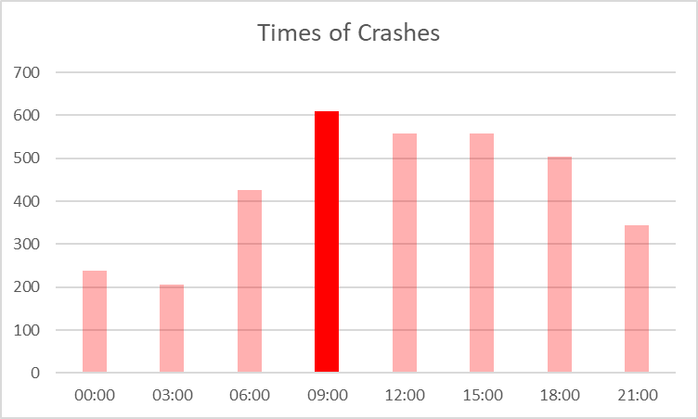
Time of crashes
Time | Crashes | Crashes
00:00 | 02:59 | 239
03:00 | 05:59 | 205
06:00 | 08:59 | 426
09:00 | 11:59 | 610
12:00 | 14:59 | 558
15:00 | 17:59 | 557
18:00 | 20:59 | 503
21:00 | 23:59 | 344

Slide 12
Most Severe crash

Slide 13
The most severe Crash
27 March 1977
Tenerife Airport
583 fatalities

Slide 14
World war II

Slide 15
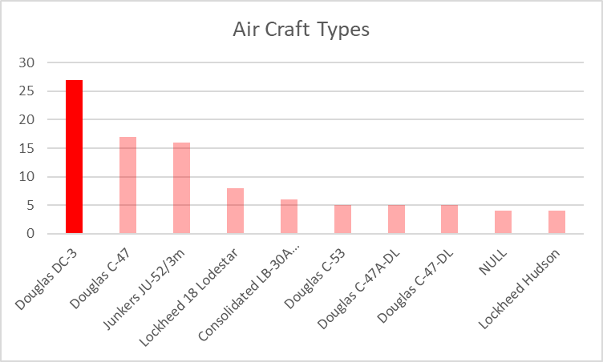
World war II aircraft types
Aircraft Type | Crashes
Douglas DC-3 | 27,00
Douglas C-47 | 17,00
Junkers JU-52/3m | 16,00
Lockheed 18 Lodestar | 8,00
Consolidated LB-30A Liberator | 6,00
Douglas C-53 | 5,00
Douglas C-47A-DL | 5,00
Douglas C-47-DL | 5,00
NULL | 4,00
Lockheed Hudson | 4,00

Slide 16
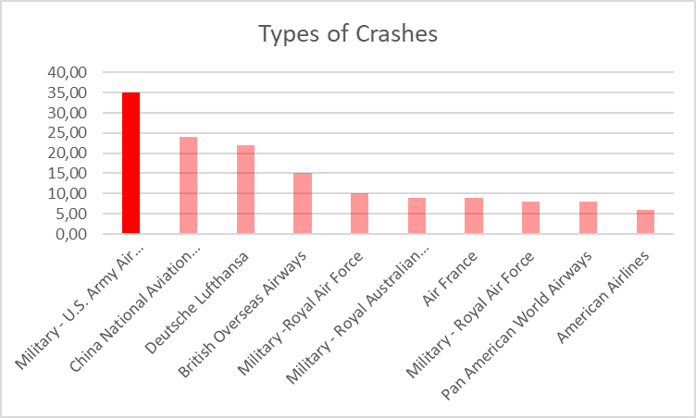
World war II types of Crashes
Operator type | Crashes
Military - U.S. Army Air Forces | 35,00
China National Aviation Corporation | 24,00
Deutsche Lufthansa | 22,00
British Overseas Airways | 15,00
Military -Royal Air Force | 10,00
Military - Royal Australian Air Force | 9,00
Air France | 9,00
Military - Royal Air Force | 8,00
Pan American World Airways | 8,00
American Airlines | 6,00

Slide 17
Total Fatalities over time

Slide 18
Fatalities over time
Advancement of technology
Training of operators
Rate of fatalities

Slide 19
SUMMARY
We have looked at how the data was prepared for analysis, analyzed 10-year periods of crashes and fatalities, times of crashes, types of aircrafts and operators and total fatalities over time.

Slide 20
THANK YOU
Mbongeni Sithole
sitholembongeni16@gmail.com
067 826 4502

